Slide 1
CSE 598-96965: Special Topics, Fall 2022 Machine Learning Security and Fairness
Towards Robust Federated Learning using Knowledge Distillation Techniques
Course Project Mid-Term Report
Group: Arindam Jain & Kiran S
Instructor: Dr. Chaowei Xiao

Slide 2
Problem Statement

Slide 3
Primary Goals
Introduce a defensive mechanism called defensive distillation.
Investigate the requirements for an effective defense.
Deep Neural Network Robustness
Speed/Accuracy Trade-offs
Empirically study the effectiveness of defensive distillation based on the requirements defined.

Slide 4
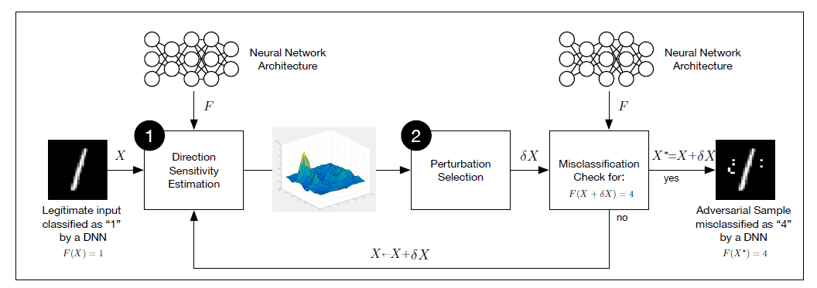
Adversarial Crafting Framework

Slide 5
Knowledge Distillation – General Use Case
Massive challenge to deploy large deep neural networks on devices with limited resources:
Mobile Phones
Network Edge Devices
Why?
High Computational Complexity
Large Storage Requirements
Knowledge Distillation is an effective model compression & acceleration technique.

Slide 6
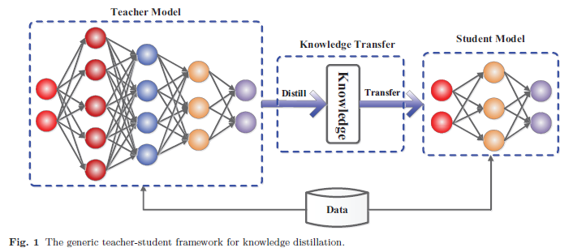
Knowledge Distillation

Slide 7

Knowledge Distillation – Key Intuition
The Knowledge of a Deep Neural Network for Classification Problems is encoded in:
Weight Parameters of the Network
Probability Vectors (Soft Labels) produced by the network
Reduce Weight Parameters => Use Probability Vectors!
Softmax Function:
z(x) = Output logits of DNN
T = Distillation Temperature
N = Number of Classes

Slide 8
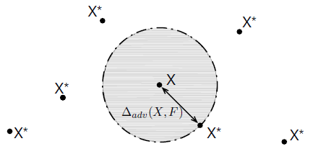
Deep Neural Network Robustness
Robustness:
Hardness Metric:
Symbols:
F = Classifier Function, X = inputs drawn from u
A Robust DNN should:
Display good accuracy inside & outside of its training set
Model a smooth classifier function F which would classify relatively consistently in the neighborhood of a sample

Slide 9
Other Defense Requirements
Low impact on the model architecture.
Maintain Accuracy.
Maintain Speed of Network.
Defenses should work for adversarial samples relatively close to points in the training dataset.

Slide 10
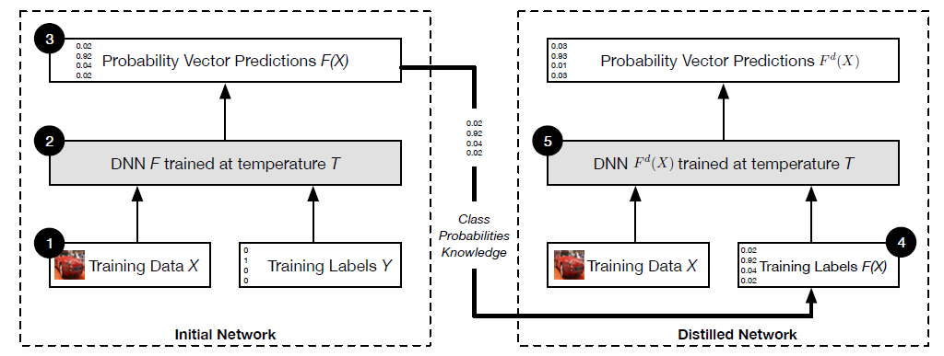
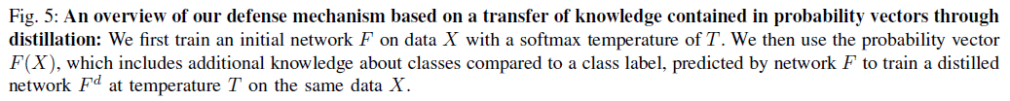
Proposed Defense Architecture

Slide 11
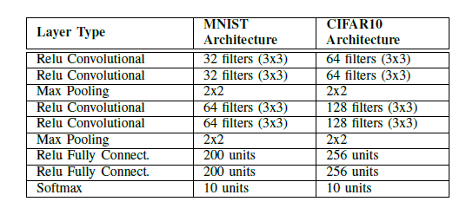
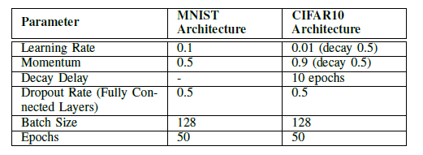
Experiment Setup

Slide 12
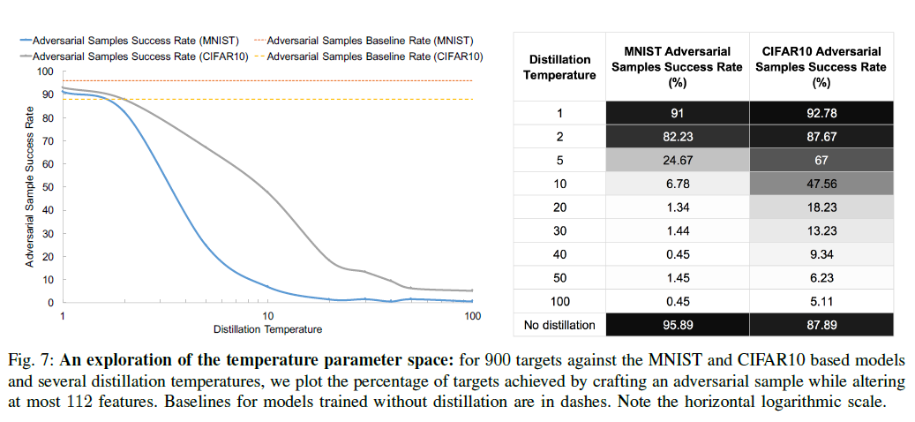
Experiment Analysis – Adversarial Sample Success Rate
Key Observations:
Increasing the Distillation Temperature essentially makes crafting adversarial samples harder.
There is a point after which the rate remains largely constant.

Slide 13
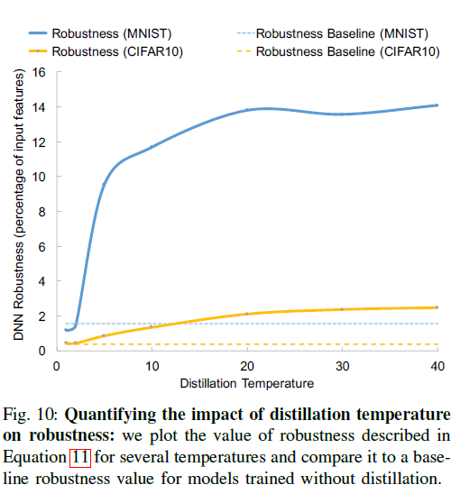
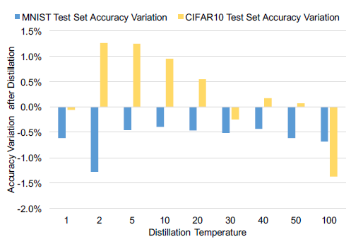
Experiment Analysis – Accuracy & Robustness

Slide 14
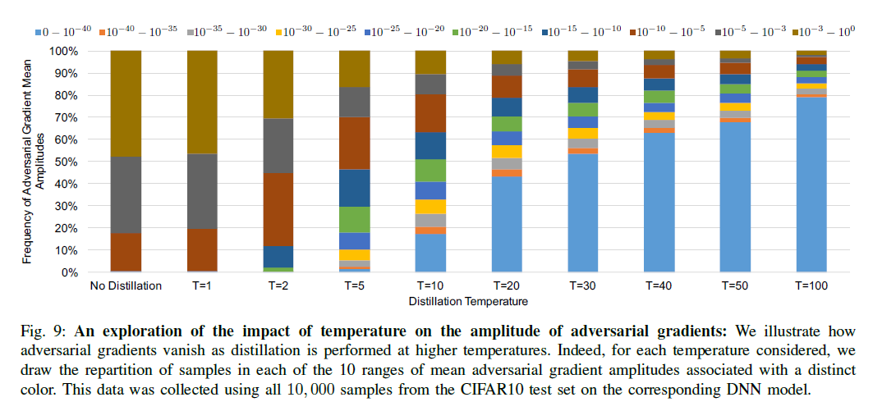
Experiment Analysis – Adversarial Gradients

Slide 15
Conclusions
A clear picture of adversarial sample crafting is presented.
A gentle introduction to Knowledge Distillation is presented.
A variant of Knowledge Distillation – Defensive Distillation is used as a potent defense mechanism for DNNs against gradient-based white-box adversarial attacks with:
Minimal accuracy tradeoffs
Increased Robustness of studied DNNs
Limited changes to DNN Architectures.

Slide 16
Strengths
Defensive Distillation is an extremely effective defense mechanism against White-Box Attacks.
Adversarial Crafting Success Rates -
For MNIST Dataset – 95.89% to 0.45%
For CIFAR10 Dataset – 87.89% to 5.11%
Minimal tradeoffs with respect to Overall Accuracy.
One of the earlier papers (2016) in the literature on Adversarial Defense Mechanisms – over 2500 citations! – used as a benchmark/reference by most novel solutions today.

Slide 17
Weaknesses
Higher number of computations required to train the overall architecture.
The scope of this paper is only for Classification Problems. A huge set of Deep Learning models need to be addressed:
Object Detection
Video Processing
Not as effective against black-box/decision-based attacks. – big problem.

Slide 18
Extensions / Improvements
More formal & broader definitions of Deep Neural Network Robustness can be defined.
Extend the scope of defensive distillation outside of classification to other Deep Learning tasks.

Slide 19
Thank you!

